Slide 1
The Time-Use Diary Method
Dr. Stella Chatzitheochari

Slide 2
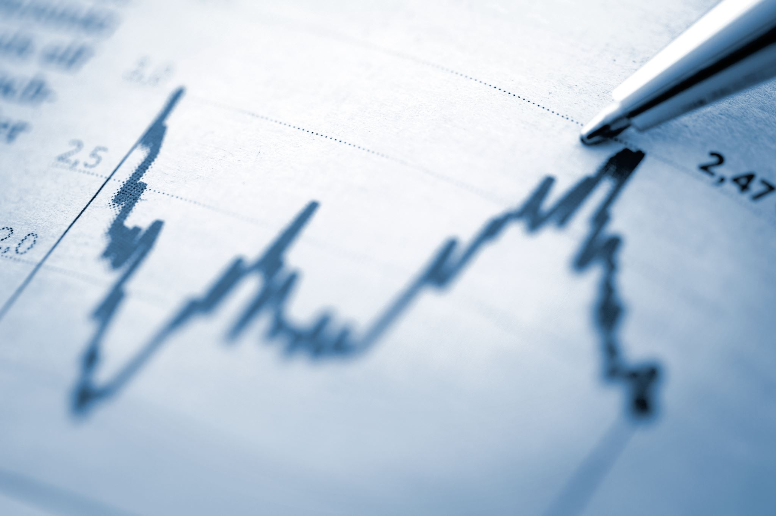
Time-Use in the Social Sciences
Several time-use domains of interest: paid work, childcare, domestic labour, sleep, exercise, screen time
Time-use: manifestation of existing social inequalities and a predictor of well-being, health, and labour market outcomes
How can we measure time-use?

Slide 3
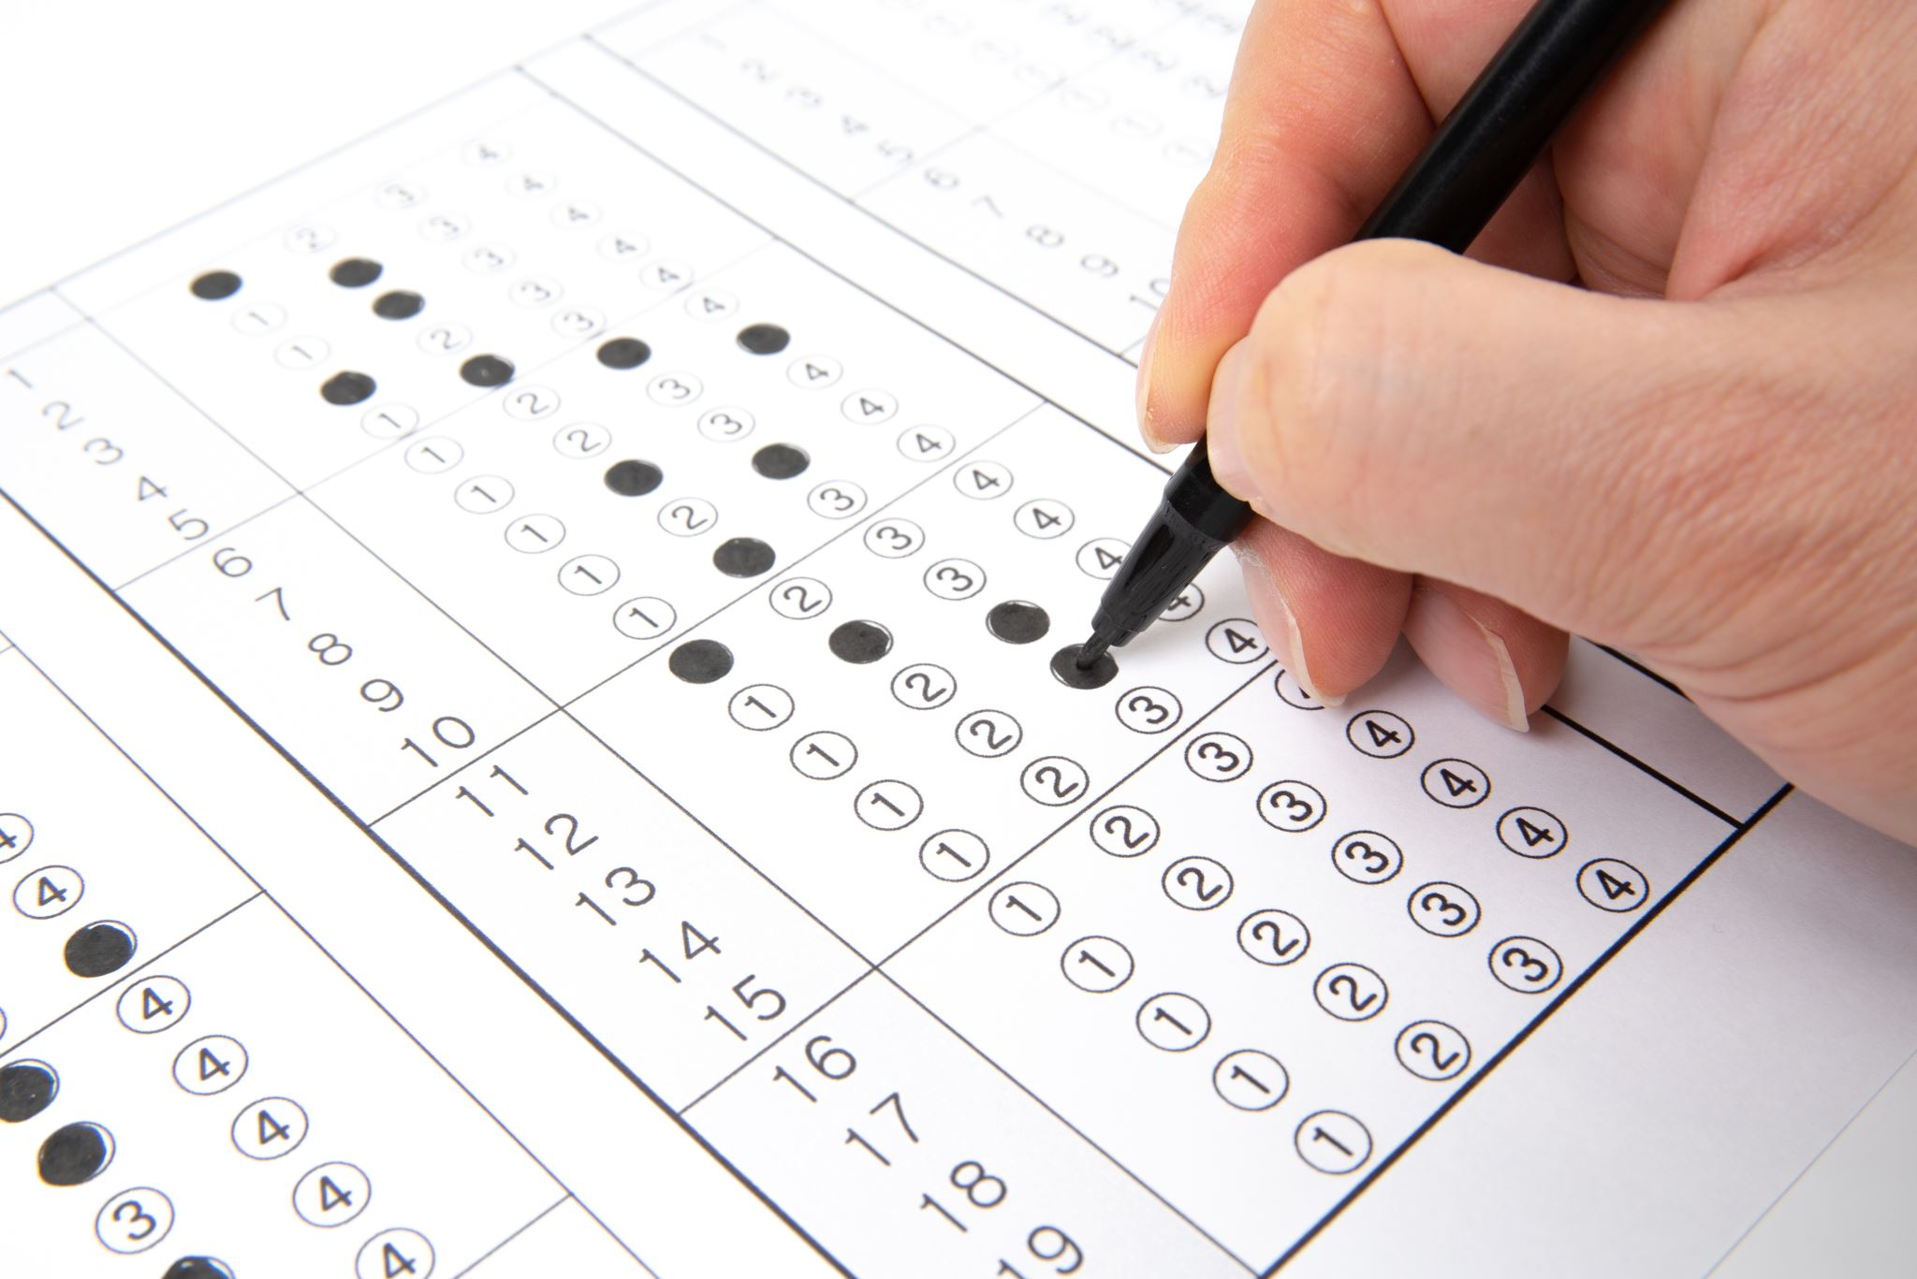
Survey Questions (I)
How many hours did you work last week?
How many times did you go to the theatre last month?
The type of activity studied determines type of question (duration vs frequency) and reference period (week vs month)

Slide 4
Time-use Survey Questions and Data Quality
Reliability and validity concerns: (1) recall and calculation difficulties, (2) social desirability (3) varying interpretations of activity “boundaries” by respondents
Questionnaires can only cover a narrow number of everyday activities
Lack of information about context:
Who did you go to the theatre with?
Where did you exercise?
Did you exercise alone?
When did you clean the house?

Slide 5
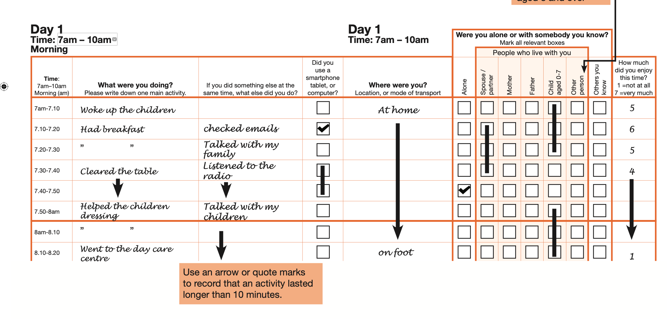
The Time-Use Diary Method

Slide 6
The Time-Use Diary Method
Administered as a social survey
Usually 2 days of the week (one weekend day and one weekday) are surveyed
Often combined with long-term time-use survey questions (e.g., volunteering, theatre)
Adds up to 24-hours (less errors) & diary format facilitates memory
Researchers group activities using harmonised activity codes
Overall, higher reliability & validity
Holistic activity account (timing/day of week, sequencing) & contextual information (location, co-presence, affect etc.)

Slide 7
www.ncrm.ac.uk

